Slide 1
EOC AND MFC
Real Time Object Detection and Person Tracking using Kalman Filtering

Slide 2
TABLE OF CONTENTS
INTRODUCTION
01
02
ALGORITHM
04
METHODOLOGY
05
RESULTS
DATASET
PENDING WORKS
03
06
Notes:
Note: you can add between 3 and 6 sections, the structure can vary. The numbers have to be kept

Slide 3
INTRODUCTION
In military operations, tracking soldiers, vehicles, and weapons is very important.
Traditional surveillance methods struggle with fast movements, poor visibility, and large areas.
Our project uses YOLOv8 to detect and track military objects automatically.
Objective : Build a system that can identify and follow soldiers and military vehicles in real-time from a video.

Slide 4
METHODOLOGY
Step 1: Writing Code to Train YOLO
Instead of collecting and labeling images manually, we write a script to train YOLOv8 using an existing dataset.
We use Ultralytics YOLOv8 for object detection.
Step 2: Train YOLOv8 Model
Use YOLOv8, a deep learning model that can detect objects in real-time.
Train it to recognize military objects with high accuracy.

Slide 5
METHODOLOGY
Step 3: Use Kalman Filter for Tracking
After detecting objects, we track their movement using the Kalman Filter.
It predicts the object's next position, even if it disappears for a moment.
Step 4: Apply on a Video
Input a military surveillance video.
The trained YOLO model detects and follows objects with unique IDs.
Save the final tracked video as output.

Slide 6
KALMAN FILTERING
The Kalman Filter is based on a model that estimates an object's position over time. It uses probability and linear algebra to predict and correct the object's movement.
State Representation:
The state of an object (e.g., a soldier or a vehicle) is represented as a state vector:
𝑥𝑘=[𝑥;𝑦;𝑣_{𝑥};𝑣_{𝑦}] ​
where:
𝑥,𝑦 → Object position (coordinates)
𝑣𝑥,𝑣𝑦​ → Object velocity in x and y directions
We track this state over time using the Kalman filter.

Slide 7
KALMAN FILTERING
2. State Transition Equation (Prediction Model)
The state evolves according to a linear difference equation:
𝑥_{𝑘}=𝐴𝑥_{𝑘−1} + 𝐵𝑢_{𝑘}+𝑤_{𝑘}
where:
A → State transition matrix (describes how the state changes over time).
𝐵𝑢_{𝑘}​ → Control input (if external forces affect the object).
𝑤_{𝑘}​ → Process noise (uncertainty in motion).
For constant velocity tracking, the state transition matrix is:
𝐴 = [1 0 Δ𝑡 0;0 1 0 Δ𝑡;0 0 1 0;0 0 0 1]
Δ𝑡 is the time step between frames.

Slide 8
KALMAN FILTERING
3. Measurement Equation (Observation Model)
We don’t directly observe the full state vector but only measure certain values (e.g., object position from YOLO detections).
The measurement model is:
𝑧𝑘 = 𝐻𝑥_{𝑘} + 𝑣_{𝑘}
where:
𝑧_{𝑘}​ → Measured observations (e.g., detected object positions).
𝐻 → Measurement matrix, mapping state variables to observed values.
𝑣_{𝑘} → Measurement noise (sensor inaccuracies).
In this case:
𝐻 = [1 0;0 0;0 1;0 0]
This extracts only the position (𝑥,𝑦) from the state vector.

Slide 9
DATASET
We need a dataset to train our YOLO model.
The dataset contains images of military objects labeled with bounding boxes.
Object Type | Example
Soldiers | Foot soldiers, armed personnel
Military Vehicles | Tanks, trucks, jeeps
Weapons | Missiles, artillery

Slide 10
ALGORITHM
Step 1: Load & Prepare Model
Check if a trained model (best.pt) exists.
• If available, load the model for detection.
• If not, train the YOLOV8 model using the labeled dataset.
Initialize the Kalman Filter for tracking object movement.
Step 2: Process Video Frames
Open the input video file.
Read each frame one by one.
Step 3: Detect Objects
Use the YOLOV8 model to detect objects in the frame.
Extract bounding box coordinates, confidence scores, and class labels.
Filter detections to focus on military objects like soldiers, tanks, and weapons.

Slide 11
ALGORITHM
Step 4: Track Objects with Kalman Filter
Assign unique IDs to detected objects.
Predict the next position of tracked objects using the Kalman Filter.
Update object positions when new detections match previous ones.
Step 5: Annotate & Save Output
Draw bounding boxes and labels on the video frame.
Display unique tracking IDs for each detected object.
Save the processed video with detection and tracking information.
Step 6: Finalize & Export Results
Release video resources after processing all frames.
Save the final tracked video as an output file.

Slide 12
RESULTS
Performance Analysis:
Accuracy:
APC (Armored Personnel Carrier): 52.9%
Military Truck: 54.0%
Person (Soldiers): 64.8%
Tank: 87.7%
Overall mAP@0.5: 64.9%

Slide 13
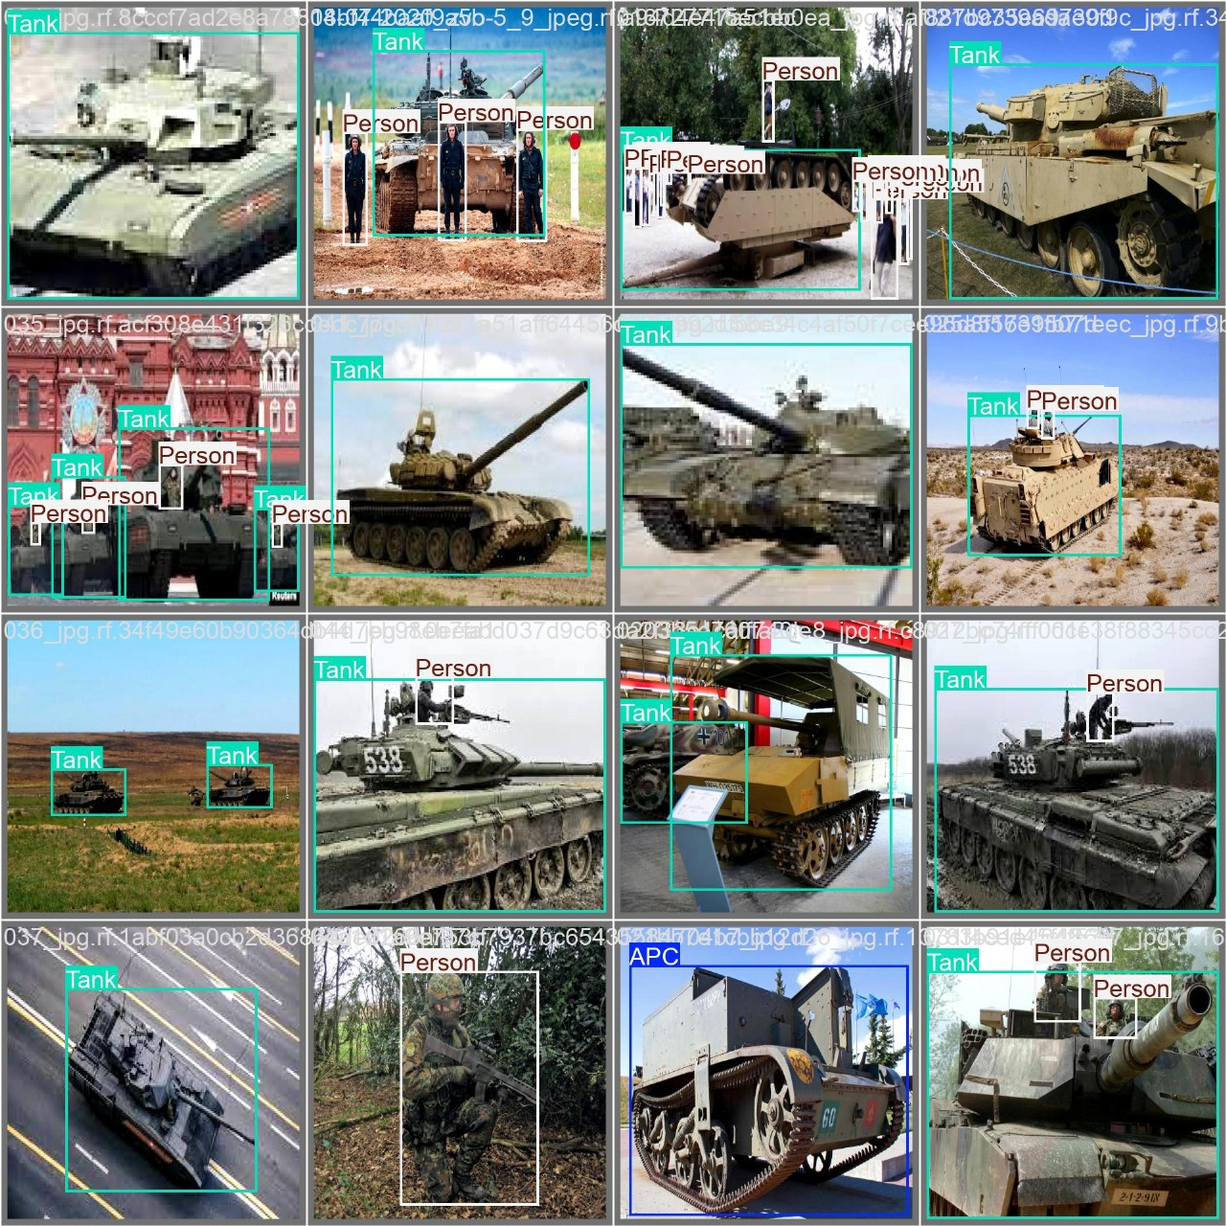
RESULTS
Example Results:

Slide 14
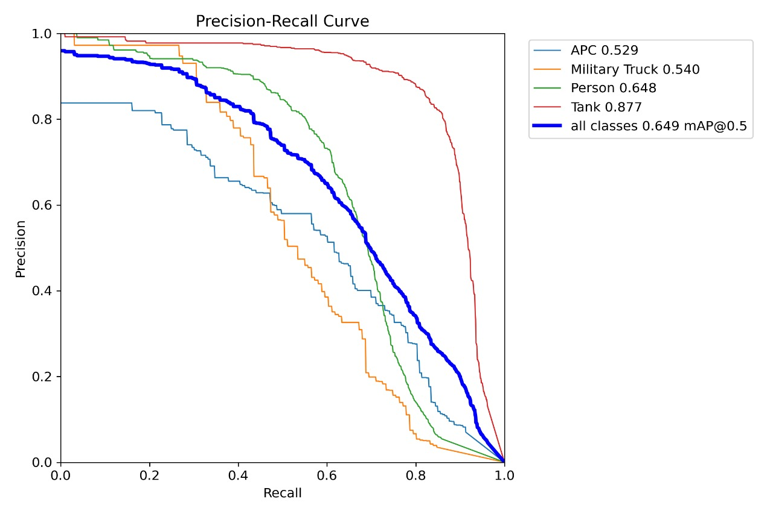
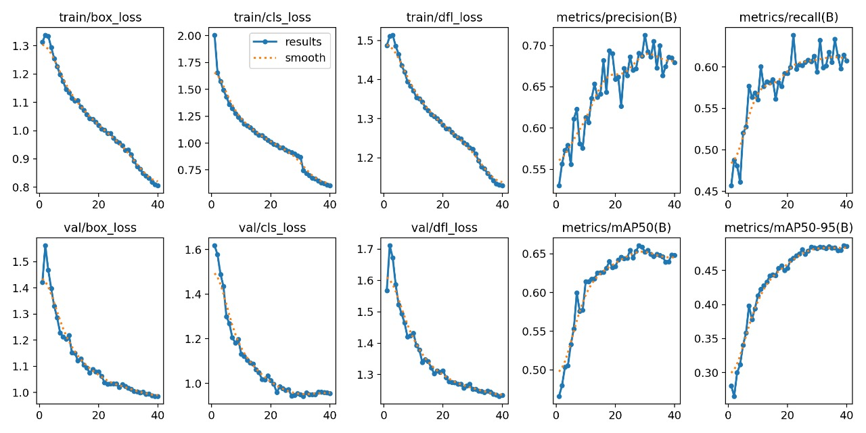
RESULTS

Slide 15
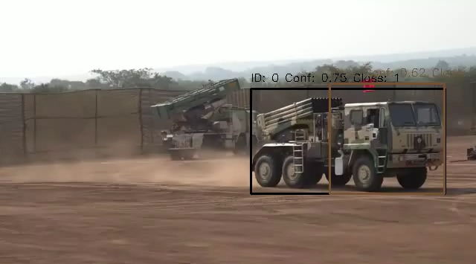
RESULTS
A video with bounding boxes and tracking IDs for each detected object.

Slide 16
PENDING WORKS
Pending Works: Since the project is currently 80% complete, the following improvements are planned to enhance system performance:
Consistent Object Tracking: The model is assigning new IDs for each frame instead of maintaining a consistent tracking ID for objects.
Object Name Display: Currently, the detected object’s name is not appearing above the bounding box.
Testing and Optimization: Testing with better datasets and making the code better

Slide 17
Thank you
CB.SC.U4AIE24023 – KIRUTHIKPRANAV
CB.SC.U4AIE24038 – MANIROOP
CB.SC.U4AIE24026 – SASANK GUPTA
CB.SC.U4AIE24060 - VIKRAM

